Slide 1

DETECTION AND FILTERING OF SPOOFED IP PACKETS
M.S. Project submitted by
Mamatha Narri
U00347863
Supervised by
Dr. Jorge Novillo
Master of Science in Computer and Information Sciences
Department of Computer Science
State University of New York Polytechnic Institute

Slide 2
OUTLINE
Introduction
Motivation
Problem statement
IP Spoofing Attacks
Methods to Detect and Filter Spoofed IP packets
Literature Review
Proposed Idea and Algorithm
Implementation and Results
Conclusion and Future Work

Slide 3
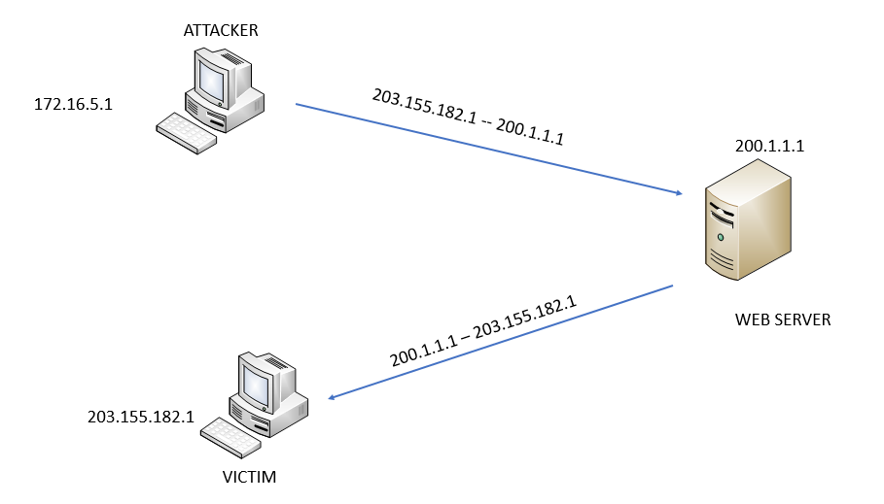
IP SPOOFING
Internet Protocol spoofing is a type of malicious attack where the threat actor hides the true source of IP packets to make it difficult to know where they came from. The attacker creates packets, changing the source IP address to impersonate a different computer system.

Slide 4
MOTIVATION
Despite knowing the IP spoofing vulnerability for many years and despite many mitigation techniques IP spoofing is a valuable tool for implementing DDoS and DRDoS attacks. IP spoofing helps the attackers to hide their identity.
There is an ongoing project called SPOOFER PROJECT by the Centre For Applied Internet Data Analysis(CAIDA) which shows there are many ASes where IP spoofing can be done. So IP spoofing is still a problem to deal with.

Slide 5
OBJECTIVE
Investigate Detection and Filtering Methods
Assess Advantages and Disadvantages
Address Disadvantages of Hop Count Filtering

Slide 6
IP SPOOFING ATTACKS
TCP SYN Flood Attack
UDP Flood Attack
DNS Reflection Attack

Slide 7
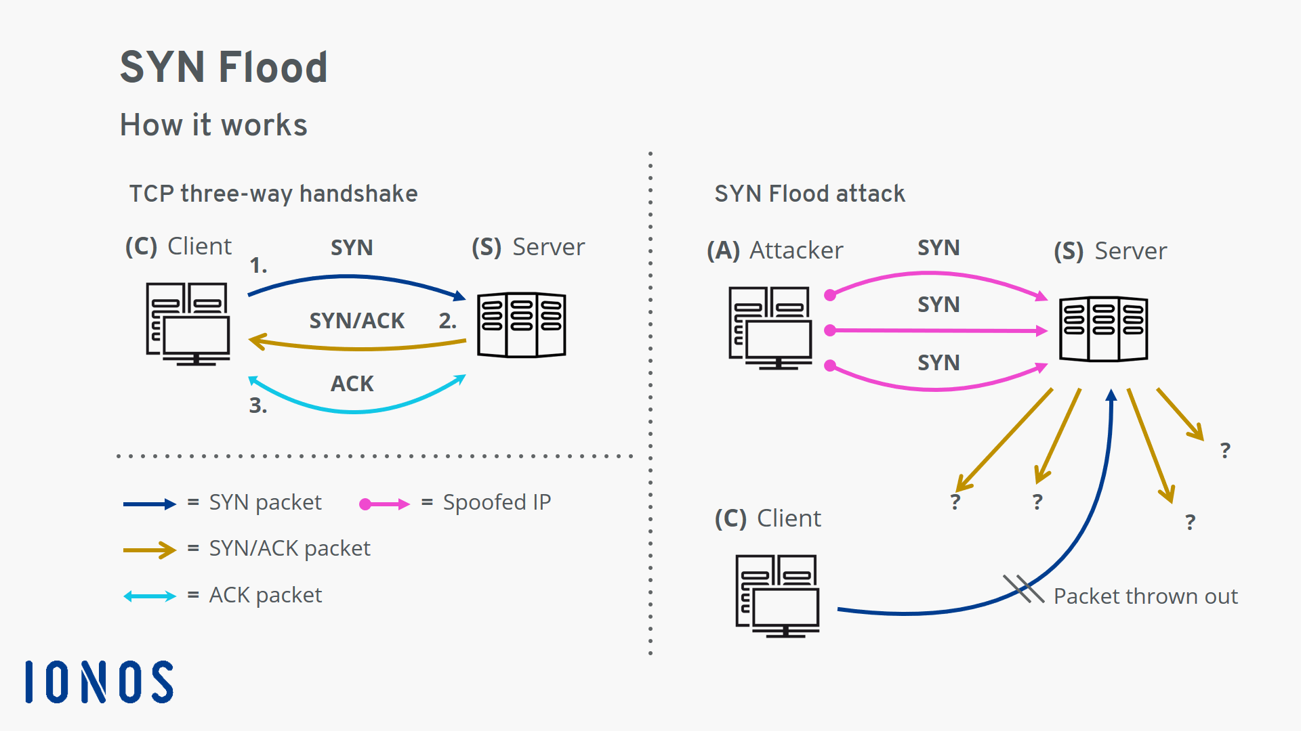
TCP SYN FLOOD ATTACK

Slide 8
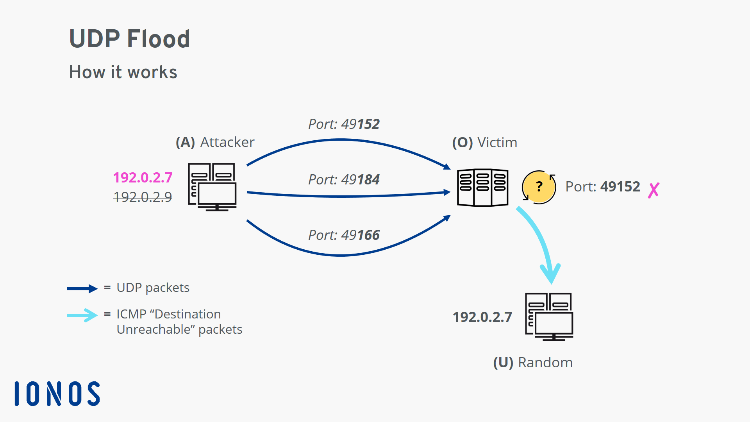
UDP FLOOD ATTACK

Slide 9
Methods to Detect and Filter Spoofed IP Packets
Ingress Filtering
Hop Count Filtering

Slide 10
LITERATURE REVIEW (Hop Count Filtering)
H. Wang, C. Jin, and K. G. Shin. Defense against Spoofed IP Traffic Using Hop-Count Filtering.IEEE/ACM Transactions on Networking (ToN), 2007: Proposed Hop Count Filtering Method.
Mopari, LB., Pukale, S.G., Dhore, M.L., "Detection and defense against DDoS attack with IP spoofing", International Conference on Computing, Communication and Networking, 2008: Implemented in Linux Kernel and shown it can be implemented using Hash table to store the IP address.
Wang, X., Li, M. and Li, M., 2009: Implemented Hop count Filtering Method at intermediate routers to save network bandwidth.
Mukaddam, A., Elhajj, I., Kayssi, A. and Chehab, A., 2014, May. IP spooﬁng detection using modiﬁed hop count: Possibility of having multiple hop count values between source and destination.

Slide 11
LITERATURE REVIEW(Ingress Filtering)
Ferguson, P. and D. Senie, ”Network Ingress Filtering , BCP 38, RFC 2827 May 2000 : Proposed Ingress Filtering
Baker, F. and P. Savola,BCP 84, RFC 3704,Mar 2004 : Proposed various ways of Implementing Ingress Filtering
Sriram, K., Montgomery, D., and J. Haas, /RFC8704, February 2020: Worked on drawbacks of Strict reverse path forwarding.

Slide 12
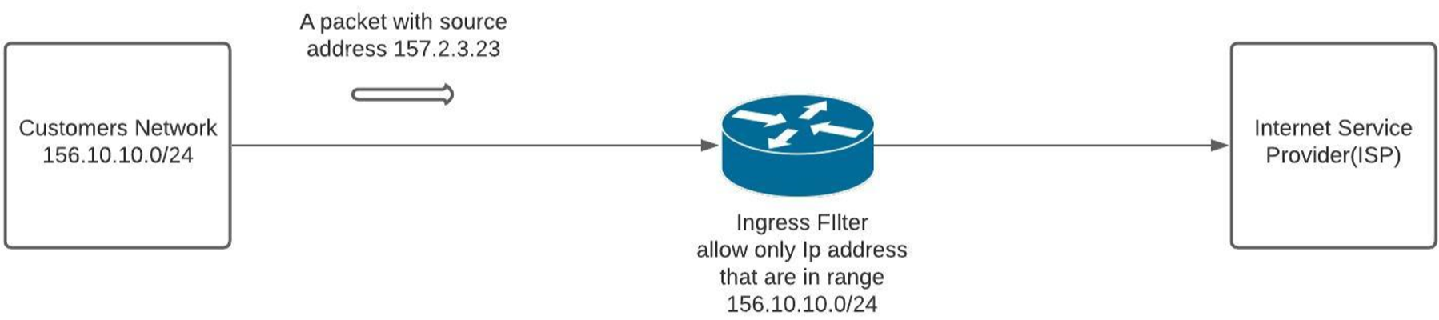
Ingress Filtering
Ingress ﬁltering is nothing but the ﬁltering of packets at the incoming interface of a network. Filtering rules are applied at the incoming interface of a network.

Slide 13
Implementing Ingress Filtering
Strict Unicast Reverse Path Forwarding
Loose Unicast Reverse Path Forwarding

Slide 14
Implementation
The above Ingress Filtering Methods are implemented on several topologies. The following setup is used to implement the methods.
IPMININET: Provides the virtual network environment and some topologies
SCAPY: A packet manipulation tool written in Python
rp_ﬁlter in Linux is used to implement the above two methods. It takes three values 0,1,2. rp ﬁlter =0 states that source address veriﬁcation is oﬀ, rp ﬁlter=1 strict reverse path forwarding method is implemented, rp ﬁlter=2 loose reverse path forwarding method is implemented.

Slide 15
Advantages:
It ﬁlters the spoofed packets at the very beginning of the network and hence can save the bandwidth of the network.
Disadvantages:
Strict reverse path forwarding suﬀers from asymmetric routing.
Loose path forwarding loses the directionality since it only checks for the presence of route and it is advised to be used on peering links.

Slide 16
Hop Count Filtering
Hop count filtering is based on the idea that one cannot easily modify the TTL(Time To Live ) filed in the IP packet as no of hops to reach the destination is not in their hands.
Using the TTL field value one can calculate the hop count by subtracting the initial ttl value from the final ttl value. Hop count is the number of routers it traversed before reaching the destination.
If every end host maintains the IP address and corresponding hop count value one can judge whether the source address is spoofed or legitimate by using the hop count value calculated when the packet reaches the host and already present hop count value for a particular IP address.

Slide 17
Inspection Algorithm
1: for every packet:
2: get the ttl value of the incoming packet which is Tx and IP address P;
3: get initial ttl value T1;
4: calculate hop count H = T1-Tx;
5: get the hop count using index P which is H1;
6: if H == H1 then
7: packet is not spoofed;
8: else
9: packet is spoofed;
10: end if

Slide 18
DRAWBACKS
Hop count table is constructed from the past data i.e. from the past one week or 1 month using traceroute.
What if a new IP address comes that is not present in the IP to Hop count table?
What if the Hop count for a particular IP address changes since routes change dynamically so does the hop count?

Slide 19
PROPOSED IDEA
We need to know a number of hop counts a particular IP address takes before applying the algorithm on a particular packet.
As soon as the packet is received the final ttl value is stored and an ICMP Echo packet is sent to the corresponding IP address to which an echo reply message is received and the final ttl value of the echo reply message is compared with the stored ttl value. Based on the comparison the IP packet is validated whether it is spoofed or not.

Slide 20
PROPOSED ALGORITHM
1: On receiving a packet:
2: store ﬁnal ttl value which is ft
3: send an ICMP request packet
4: if replied ICMP packet is of type destination unreachable and code message is host
unreachable then
5: Packet is spoofed
6: else
7: extract ﬁnal ttl value of the receiving ICMP reply packet fr
8: if fr == ft then
9: Packet is not spoofed
10: else
11: Packet is spoofed
12: end if
13: end if

Slide 21
IMPLEMENTATION
The proposed algorithm is implemented on several topologies. The following setup is used to implement the algorithm.
IPMININET: Provides the virtual network environment and some topologies
SCAPY: Packet manipulation tool written in Python
The Proposed algorithm is implemented for the following two scenarios:
If the source IP address host exists on the Internet.
If the source IP address host doesn’t exist but the network exists on the internet.

Slide 22
RESULTS
1. If the source IP address host exists in the Internet:
Type of Filtering Method | Number of spoofed packets sent | Number of packets detected as spoofed | Number of legitimate packets sent | Number of packets detected as legitimate
HCF method | 250 | 250 | 250 | 0
Proposed Algorithm | 250 | 250 | 250 | 250

Slide 23
2. If the source IP address host doesn’t exist but network exists on the internet
Type of Filtering Method | Number of spoofed packets sent | Number of packets detected as spoofed | Number of legitimate packets sent | Number of packets detected as legitimate
HCF method | 250 | 250 | 250 | 0
Proposed Algorithm | 250 | 250 | 250 | 250

Slide 24
CONCLUSION
We worked on two of the detection and ﬁltering methods which are Hop Count Filtering and Ingress ﬁltering. After implementing both of these methods we saw the advantages, and disadvantages of both of these methods and also worked on one of the disadvantages of the Hop count Filtering method which is when a new client sends a request to the receiving host that runs the hop count ﬁlter process sees it as spoofed one and discards it. To it, we proposed an algorithm which can help to tackle the disadvantage.

Slide 25
FUTURE WORK
Further experiment on the proposed algorithm in a case where the spoofed IP address network doesn’t exist on the Internet.
Time that the proposed algorithm takes to process the request.

Slide 26
References
Socolofsky, T. and C. Kale, ”TCP/IP tutorial”, RFC 1180, DOI 10.17487/RFC1180, January 1991, RFC 1180 - TCP/IP tutorial, January 1991 - » RFC Editor
Postel, J., ”Internet Protocol”, STD 5, RFC 791, DOI 10.17487/RFC0791, September 1981, Information on RFC 791
https://www.juniper.net/documentation/us/en/software/junos/interfaces security-devices/topics/topic-map/security-interface-IPV4-IPV6-protocol.html
https://docs.oracle.com/cd/E19455-01/806-0916/6ja85399u/index.html

Slide 27
http://www.steves-internet-guide.com/IPV4-basics
https://www.computernetworkingnotes.com/ccna-study-guide/basic subnetting-in-computer-networks-explained.html
Fuller, V. and T. Li, ”Classless Inter-domain Routing (CIDR): The Internet Address Assignment and Aggregation Plan”, BCP 122, RFC 4632, DOI10.17487/RFC4632, August 2006, Information on RFC 4632 » RFC Editor
https://study-ccna.com/what-is-IP-routing/
What is IP spoofing? | Cloudflare
Eddy, W., ”TCP SYN Flooding Attacks and Common Mitigations”, RFC 4987, DOI 10.17487/RFC4987, August 2007, Information on RFC 4987
Postel, J., ”Transmission Control Protocol”, STD 7, RFC 793, DOI 10.17487/RFC0793, September 1981, Information on RFC 793 » RFC Editor

Slide 28
UDP flood DDoS attack | Cloudflare
Memcached DDoS attack | Cloudflare
https://www.tutorialspoint.com/memcached/memcached overview.htm
Wang, H., Jin, C. and Shin, K.G., 2007. Defense against spoofed IP traﬃc using hop-count ﬁltering. IEEE/ACM Transactions on networking, 15(1), pp.40-53.
Ferguson, P. and D. Senie, ”Network Ingress Filtering: Defeating Denial of Service Attacks which employ IP Source Address Spooﬁng”, BCP 38, RFC 2827, DOI 10.17487/RFC2827, May 2000,https://www.rfc-editor.org/info/rfc2827
https://spoofer.caida.org/summary.php
Default TTL values in TCP/IP., 2002, [online] Available:
Mopari, I.B., Pukale, S.G. and Dhore, M.L., 2008, December. Detection anddefense against DDoS attack with IP spooﬁng. In 2008 International Conference on Computing, Communication and Networking (pp. 1-5). IEEE.

Slide 29
Wang, X., Li, M. and Li, M., 2009, December. A scheme of distributed hop count ﬁltering of traﬃc. In IET International Communication Conference on Wireless Mobile and Computing (CCWMC 2009) (pp. 516-521). IET.
Mukaddam, A., Elhajj, I., Kayssi, A. and Chehab, A., 2014, May. IP spooﬁng detection using modiﬁed hop count. In 2014 IEEE 28th International Conference on Advanced Information Networking and Applications (pp. 512-516). IEEE.
Baker, F. and P. Savola, ”Ingress Filtering for Multihomed Networks”, BCP 84, RFC 3704, DOI 10.17487/RFC3704, March 2004, Information on RFC 3704 » RFC Editor
Sriram, K., Montgomery, D., and J. Haas, ”Enhanced Feasible-Path Unicast Reverse Path Forwarding”, BCP 84, RFC 8704, DOI 10.17487/RFC8704, February 2020, Information on RFC 8704

Slide 30
https://arxiv.org/abs/1606.07613v1
GitHub Survived the Biggest DDoS Attack Ever Recorded - WIRED
Postel, J., ”Internet Control Message Protocol”, STD 5, RFC 792, DOI 10.17487/RFC0792, September 1981, Information on RFC 792 » RFC Editor
https://ipmininet.readthedocs.io/en/latest/getting started.html
http://mininet.org/
https://scapy.readthedocs.io/en/latest/introduction.html

Slide 31
Thank you

